Slide 1
Waters of the Big Sandy River Watershed
from “The Virginia Headwaters of the Big Sandy River: A Story of Revitalization and Nature’s Resilience”

Slide 2
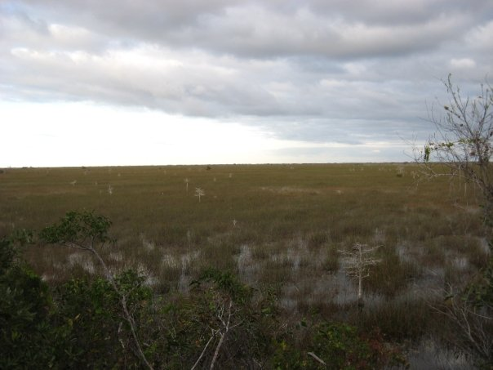
Wetlands
What is a wetland?
An area that is either permanently flooded or where soils are partially saturated with water at all times
Home to plants that love water and can survive in areas of low oxygen
Naturally formed from seeps and springs or in depressed extensions of a floodplain

Slide 3
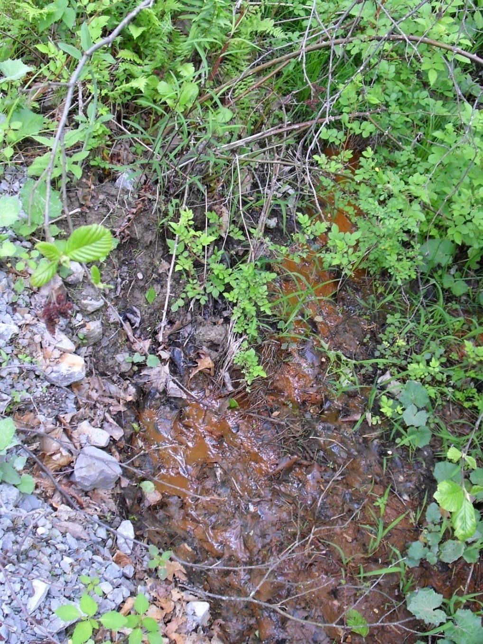
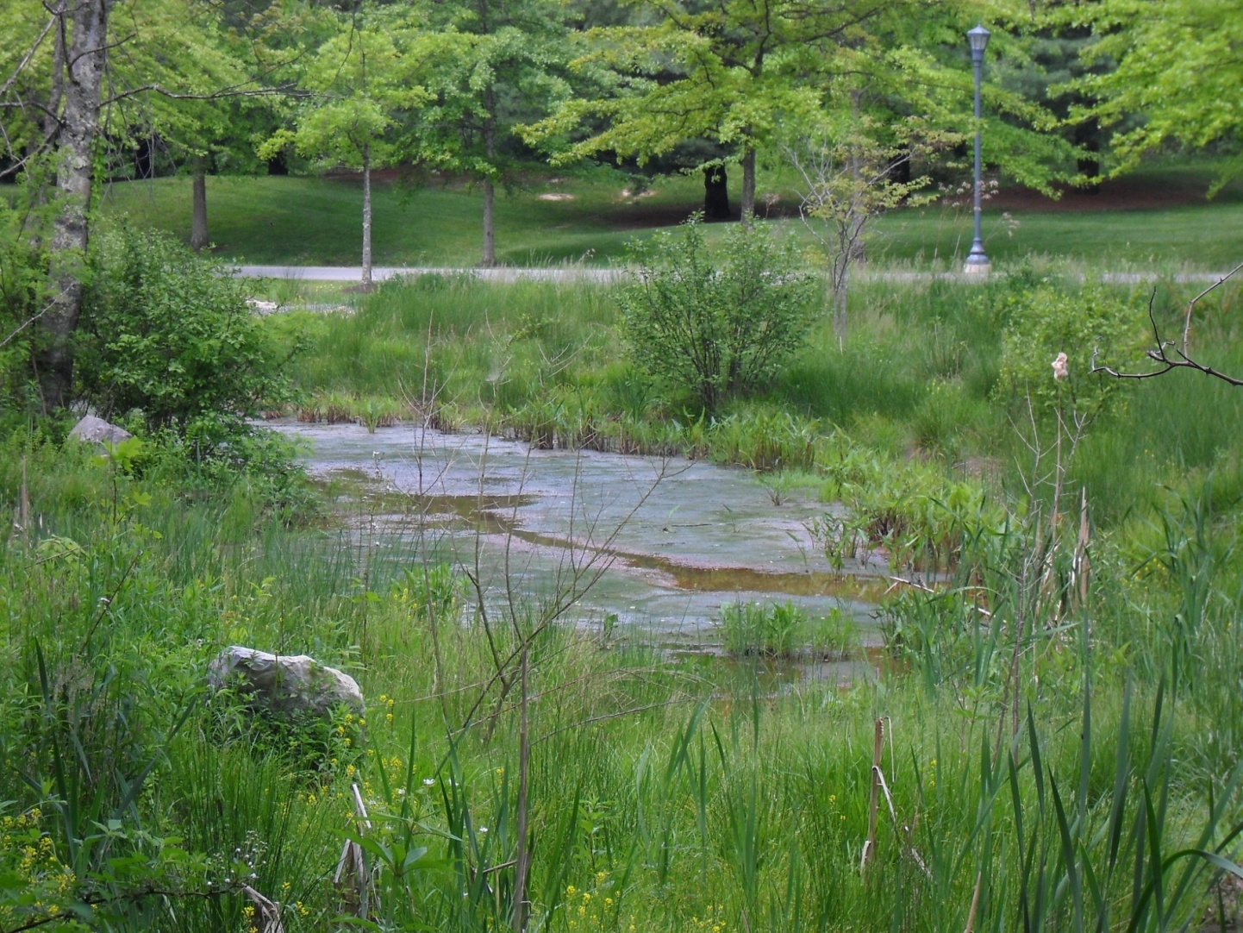
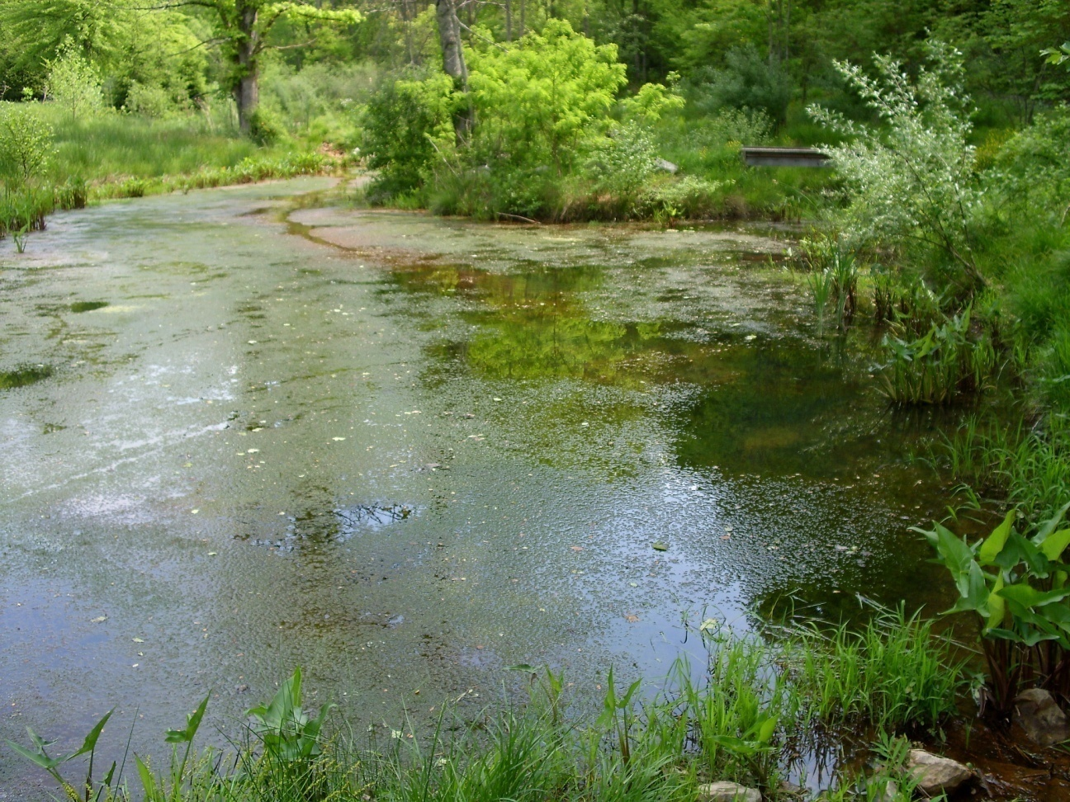
Wetlands
Why should we care about them?
The Headwaters contains ~ 167 acres of wetlands
Act as filtration systems (Nature’s Kidneys)
Reduces flooding
Treats acid mine drainage
Protected since many plants and animals are becoming endangered or threatened
Home to hydrophilic animals and migratory birds

Slide 4
Impaired Waters
What do impaired waters consist of?
Any water body or segment of a water body that violates limits set for a water quality standard
32 segments of the Headwaters are recognized as impaired
due to fecal coliform violations, low dissolved oxygen measurements, poor benthic populations, or PCB contaminations

Slide 5
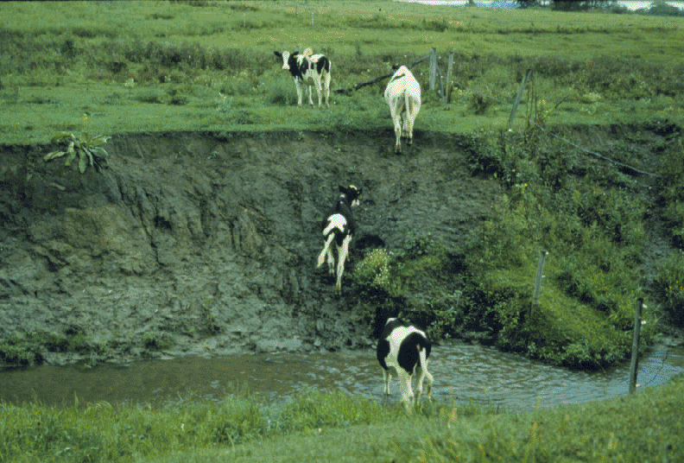
Fecal Coliform Violations
Escherichia coli (E. Coli) a type of fecal coliform bacteria
lives in digestive system of warm-blooded organisms
presence in water indicates high loading of human or animal wastes
Fate and Transport of Fecal Coliform Bacteria

Slide 6
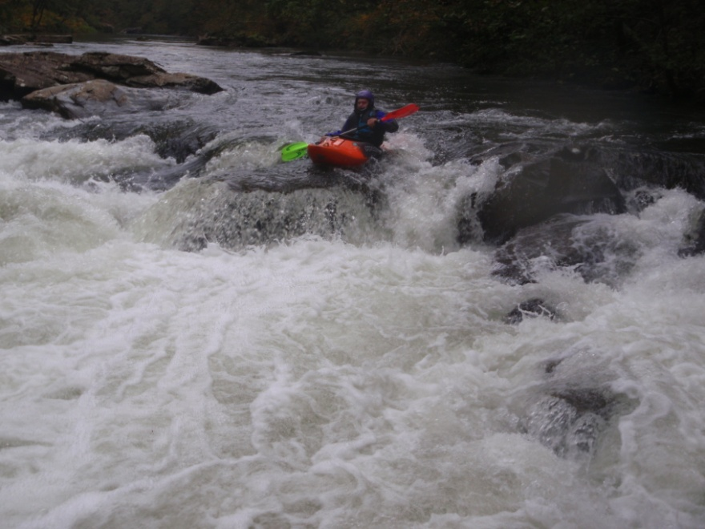
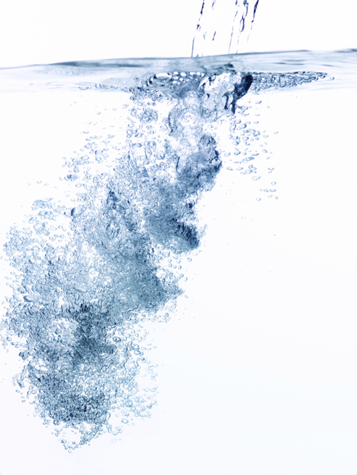
Low Dissolved Oxygen
DO = amount of oxygen present in a water column
DO is critical for life in a body water
Running water, submerged aquatic vegetation DO
Increased temperatures, animal respiration DO

Slide 7
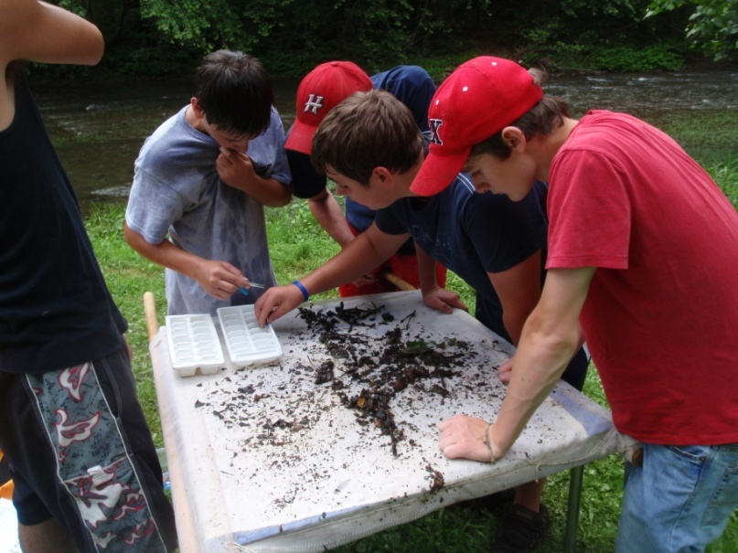
Benthic Macroinvertebrates
Poor benthic communities indicates poor water quality
Reside on the bottom of stream
Macro = large enough to see with the naked eye
Invertebrates = organisms w/o backbone
Some Haysi High School students trying out the Virginia Save Our Streams method
Online step-by-step identification key

Slide 8
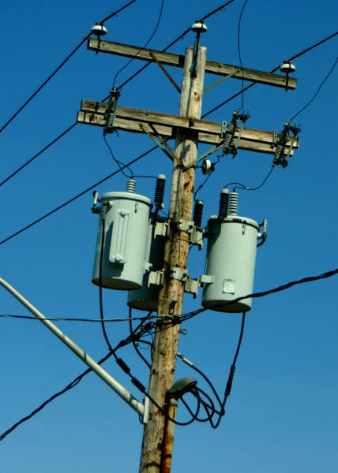
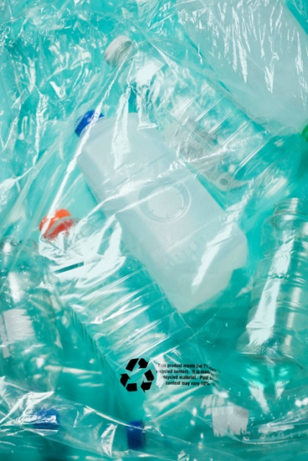
PCBs or Polychlorinated Biphenyls
man-made compounds
used to make oil w/ low risk of flammability
spilled and dumped in many places before hazard was known

Slide 9
Impaired Streams of the Virginia Headwaters of the Big Sandy River
Old Watershed | New Watershed | VA County | Stream Name | Reason for Impairment
Q03R | BS06 | Buchanan | Pawpaw Creek | Benthic Macroinvertebrates
Q03R | BS04, BS05, BS06 | Buchanan | Knox Creek | Bacteria
Q03R | BS04, BS05, BS07 | Buchanan | Knox Creek | Benthic Macroinvertebrates
Q03R | BS04, BS05, BS08 | Buchanan | Knox Creek & tributaries | PCB
Q03R | BS05 | Buchanan | Guess Fork | Bacteria
Q04R | BS09, BS12, BS14 | Buchanan | Levisa Fork & tributaries | Bacteria
Q04R | BS12, BS14, BS15 | Buchanan | Levisa Fork & tributaries | Benthic Macroinvertebrates
Q04R | BS09 | Buchanan | Levisa Fork | Chlorides
Q04R | BS08, BS09 | Buchanan | Levisa Fork & Garden Creek | PCB
Q04R | BS08 | Buchanan | Garden Creek | Bacteria
Q04R | BS08 | Buchanan | Garden Creek | Benthic Macroinvertebrates
Q04R | BS08 | Buchanan | Garden Creek | Chlorides
Q05R | BS11 | Buchanan | Dismal Creek | Temperature
Q08R | BS14 | Buchanan | Bull Creek & tributaries | Bacteria
Q08R | BS14 | Buchanan | Bull Creek & tributaries | Benthic Macroinvertebrates
Q09R | BS26 | Buchanan/Dickenson | Russell Fork | Bacteria
Q09R | BS17 | Dickenson | Sullivan Branch | Benthic Macroinvertebrates
Q11R | BS25 | Dickenson | McClure River | Bacteria
Q11R | BS25 | Dickenson | McClure River | Benthic Macroinvertebrates
Q12R | BS26 | Buchanan/Dickenson | Russell Prater Creek | Bacteria
Q12R | BS26 | Buchanan/Dickenson | Russell Prater Creek | Benthic Macroinvertebrates
Q12R | BS27 | Dickenson | Russell Fork | PCB
Q12R | BS35 | Dickenson | Russell Fork | Bacteria
Q13L | BS30, BS33, BS34 | Dickenson | John Flannagan Reservoir | Dissolved Oxygen
Q13L | BS28 | Dickenson | North Fork Pound Reservoir | Dissolved Oxygen
Q13R |  | Dickenson/Wise | North Fork Pound River | Bacteria
Q13R | BS28 | Dickenson | South Fork Pound River & tributaries | Benthic Macroinvertebrates
Q13R | BS28 | Dickenson/Wise | North Fork Pound River | Benthic Macroinvertebrates
Q13R | BS30 | Dickenson | Pound River | Bacteria
Q13R | BS30 | Dickenson | Pound River | Benthic Macroinvertebrates
Q13R | BS30 | Dickenson | Bear Pen Branch | Benthic Macroinvertebrates
Q14R | BS33 | Dickenson | Cranesnest River | Bacteria

Slide 10
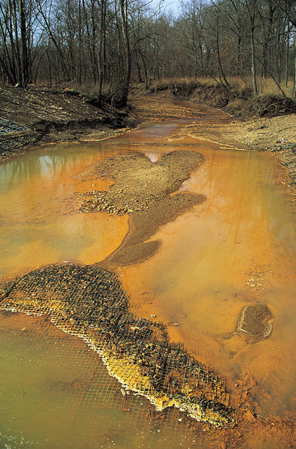
Toxic Spills in the Headwaters
Acid Mine Drainage
Impoundment Failure
Mine water release
Iron hydroxide precipitate (orange) in a Missouri stream receiving acid drainage from surface coal mining.

Slide 11
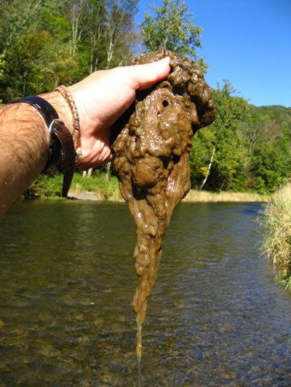
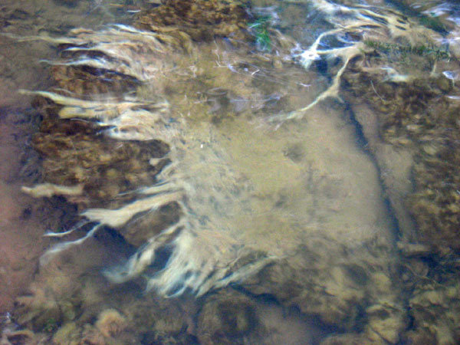
Didymo
Didymo video for Allegheny County, VA

Slide 12
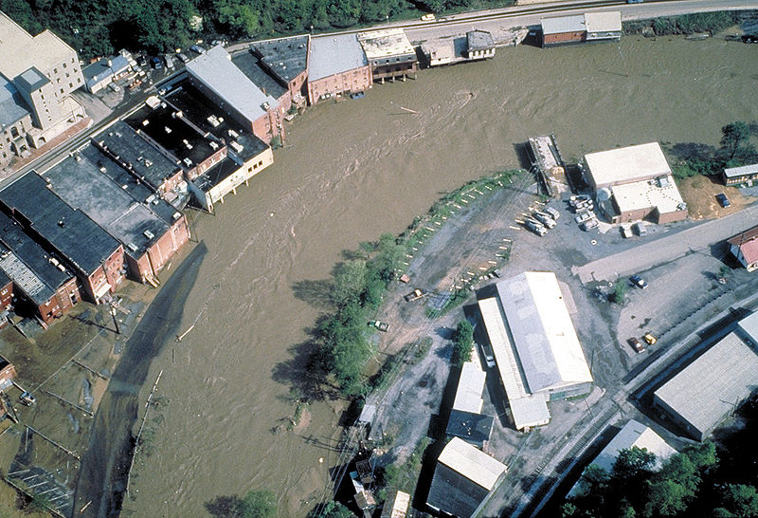
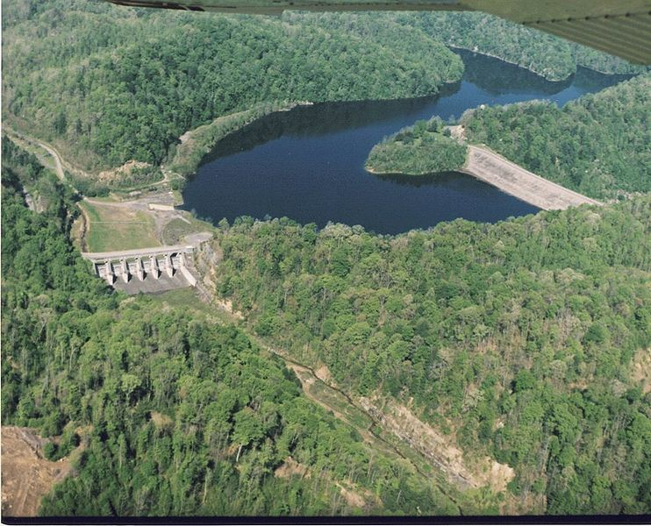
Floodplain Management
Normal for stream ecosystem… but worsened by human impacts such as deforestation
John Flannagan Dam created for flood management and water supply
Aerial view of flooding on the Levisa Fork River in Grundy, Virginia, USA, in 1984

Slide 13
Photo Credits
Wetlands photo – Florida Everglades courtesy of Nicole Tucker
Wetlands photos – UVA-Wise wetlands for AMD treatment courtesy of Audrey Mullins, Guest River Restoration Project
Cows in Stream – courtesy of Wisconsin Department of Natural Resources
Russell Fork photo – courtesy of Gene Counts
VA SOS photo – courtesy of Nicole Tucker
Acid Mine Drainage – courtesy of D. Hardesty, USGS Columbia Environmental Research Center.
Didymo photos – courtesy of Tim Daley, PA DEP
Grundy flood and John Flannagan Dam photos – courtesy of U.S. Army Corps of Engineers

